Slide 1
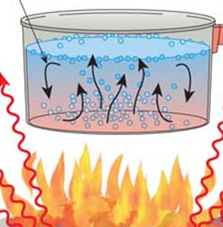
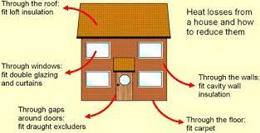
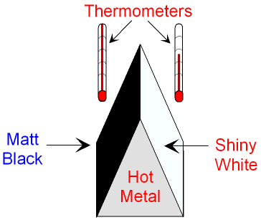
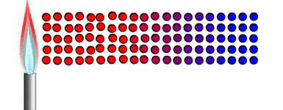


Knowledge Organiser
Year 8: Heating and Cooling – Transferring Heat
How does convection work?
Convection is the transfer of heat by moving particles
When particles in a fluid they gain energy and move away from each other
The particles are then replaced by ones with less energy
How does heat escape our homes?
It is transferred by conduction through the walls, floor, roof and windows
It is also transferred by convection as cold air can enter through gaps in doors and windows
Temperature vs. Heat:
Temperature is a measure of how hot something is
Heat is a measure of the thermal energy in an object
Temperature is measured in ⁰C
Heat energy is measured in J
How does heat energy behave?
Heat energy will flow from hotter to colder regions
It can flow by conduction, convection or radiation
Diagram which shows the transfer of heat energy by moving particles in a fluid
How do insulation methods work?
Double glazing prevents heat loss by conduction as the air between the panels is a poor conductor
Cavity wall insulation inside walls is full of air pockets, which also prevents conduction
Carpets, curtains and draught excluders prevent the flow of cold air through convection
How does conduction work?
Conduction is the movement of heat by vibrating particles
The particles do no move from their position, they vibrate around a fixed point
When part of a solid absorbs heat energy the particles vibrate faster
The vibrations are passed between particles
Diagram which shows ways to prevent loss of heat energy from the home
How does thermal radiation work?
Infrared (thermal) radiation is a type of electromagnetic radiation
When infrared radiation is absorbed by an object it is heated and its temperature rises
Unlike conduction and convection it does not require particles so can work in the vacuum of space
Diagram which shows the transfer of heat energy by vibrating particles
RAG Yourself!
What types of surfaces absorb thermal radiation the best?
Emit means to give out energy
Absorb means to take in energy
Dark surfaces are better at both absorbing and emitting heat energy than light ones
Matt (rough) surfaces are better at absorbing and emitting heat energy than shiny ones
A black car would both heat up more quickly on a hot day and cool down more quickly on a cold day
Learning Outcomes; | RAG
Describe how conduction transfers thermal energy
Define insulator and conductor with examples
Describe how convection transfers thermal energy
Describe how surfaces affect thermal radiation
State methods used to reduce heat transfer at home
Explain insulation methods in terms of reducing conduction, convection or thermal radiation
Which are the best conductors?
Solids are the best conductors of heat
Their particles are close together so can easily pass on vibration
Metals are even better because they have free electrons which can move throughout the substance carrying thermal energy with them

Slide 2
Knowledge Organiser
Year 8: Heating and Cooling – Transferring Heat
How does convection work?
How does heat escape our homes?
Temperature vs. Heat:
How does heat energy behave?
Diagram which shows the transfer of heat energy by moving particles in a fluid
How do insulation methods work?
How does conduction work?
Diagram which shows ways to prevent loss of heat energy from the home
How does thermal radiation work?
Diagram which shows the transfer of heat energy by vibrating particles
RAG Yourself!
What types of surfaces absorb thermal radiation the best?
Learning Outcomes; | RAG
Describe how conduction transfers thermal energy
Define insulator and conductor with examples
Describe how convection transfers thermal energy
Describe how surfaces affect thermal radiation
State methods used to reduce heat transfer at home
Explain insulation methods in terms of reducing conduction, convection or thermal radiation
Which are the best conductors?

